Slide 1
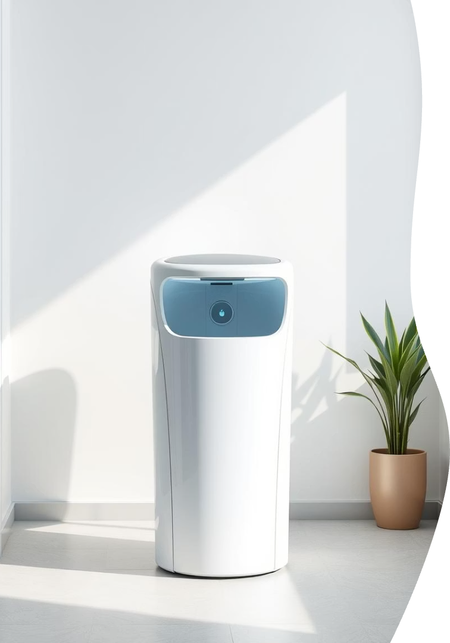
Smart Dustbin Using IoT
This presentation explores a smart dustbin system enabled by IoT. It transforms waste management with intelligent detection and sorting capabilities.
Presented By :
01 - Suraj Chauhan
06 - Patel Sahil
10 - Sharma Utsav

Slide 2
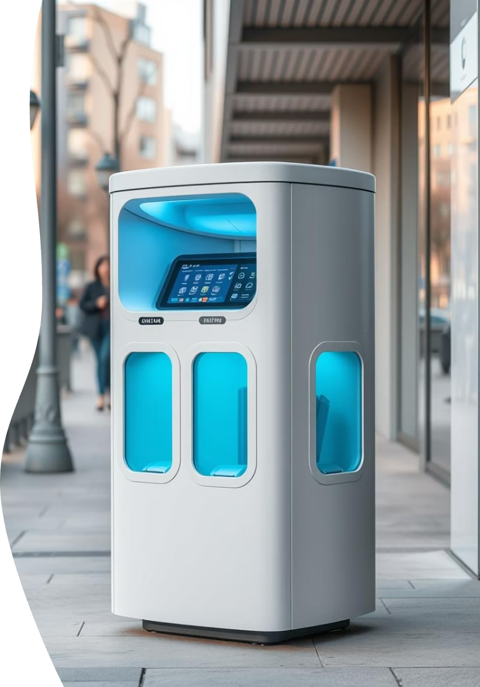



What is a Smart Dustbin?
Intelligent waste management
Optimized path routing
Uses sensors and IoT to monitor and sort waste automatically.
Helps plan efficient waste collection routes based on bin fill levels and location data.
Environmental impact
Enhances recycling efforts by accurate waste segregation.

Slide 3
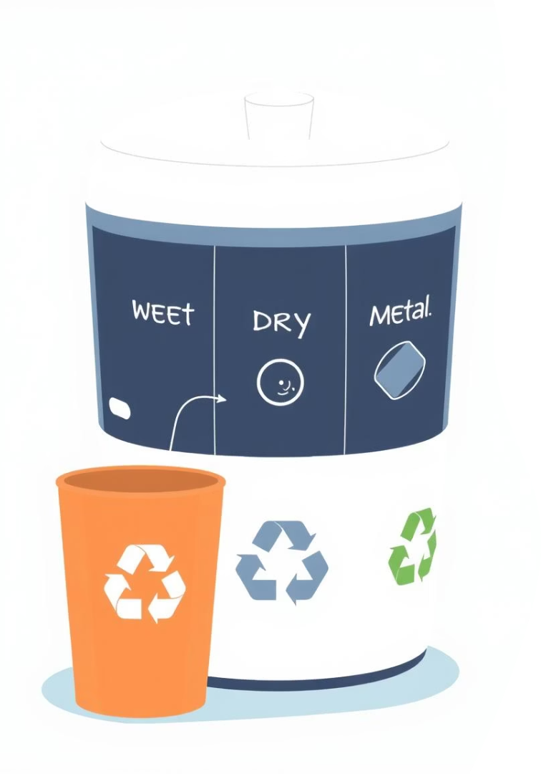
In Our Project: Waste Detection and Separation
Wet Waste
Dry Waste
Metal Waste
Paper, plastics, and non-organic decomposable waste.
Cans, foil, and other recyclable metals detected.
Food scraps, vegetables, and organic materials.

Slide 4




Objectives of the Smart Dustbin
Automate Waste Sorting with Precision
Enhance Recycling Efficiency
Encourage proper disposal habits by providing clear waste category detection, thereby increasing recycling rates and maximizing recovery of reusable materials.
Utilize sensor technology and machine learning algorithms to accurately identify and separate wet, dry, and metal waste, reducing human intervention and minimizing sorting errors.
Real-time Waste Level Monitoring
Leverage IoT sensors to track bin fill levels continuously, enabling timely alerts for waste collection and preventing overflow, thus maintaining public hygiene and safety.

Slide 5
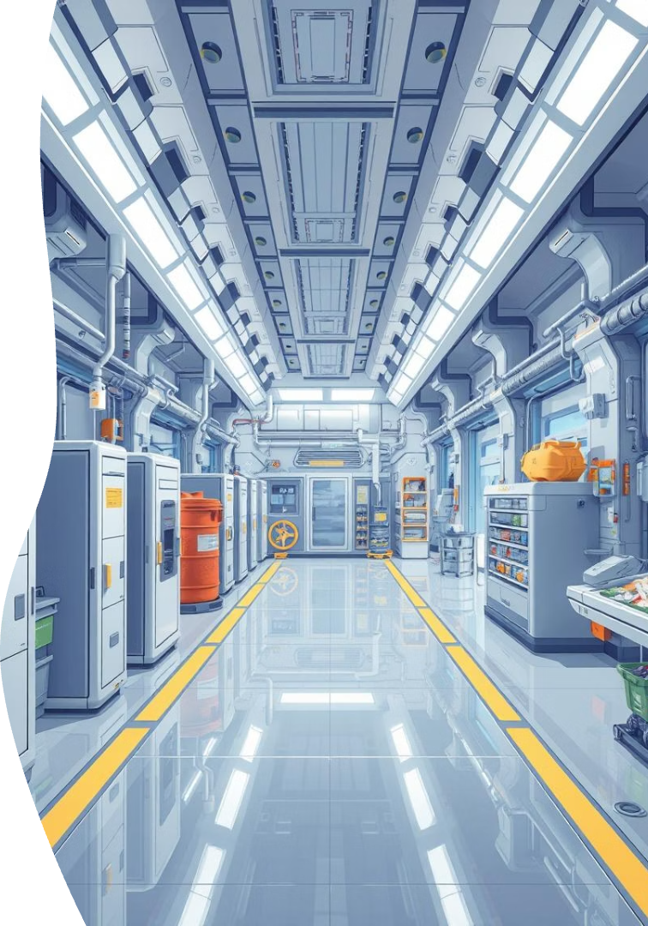
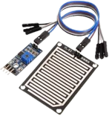
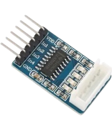
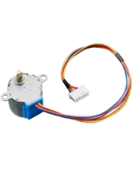
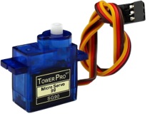
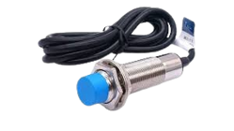
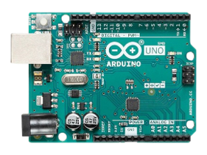
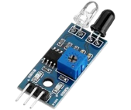
Devices Used In Project
Name | Description | Images
Arduino Uno SMD | Small computer you can program to control things like lights, motors, and sensors.
9g Servo Motor | Small motor that turns to a set angle. Used in toys and robots.
Stepper Motor | Motor that moves in steps. Good for precise movement like 3D printers.
Stepper Motor Driver | Small board that controls the stepper motor.
Raindrop Sensor | Tells if it's raining or wet.
IR Sensor | Sees objects using invisible light.
Proximity Sensor | Senses when something is close. No touch needed.

Slide 6
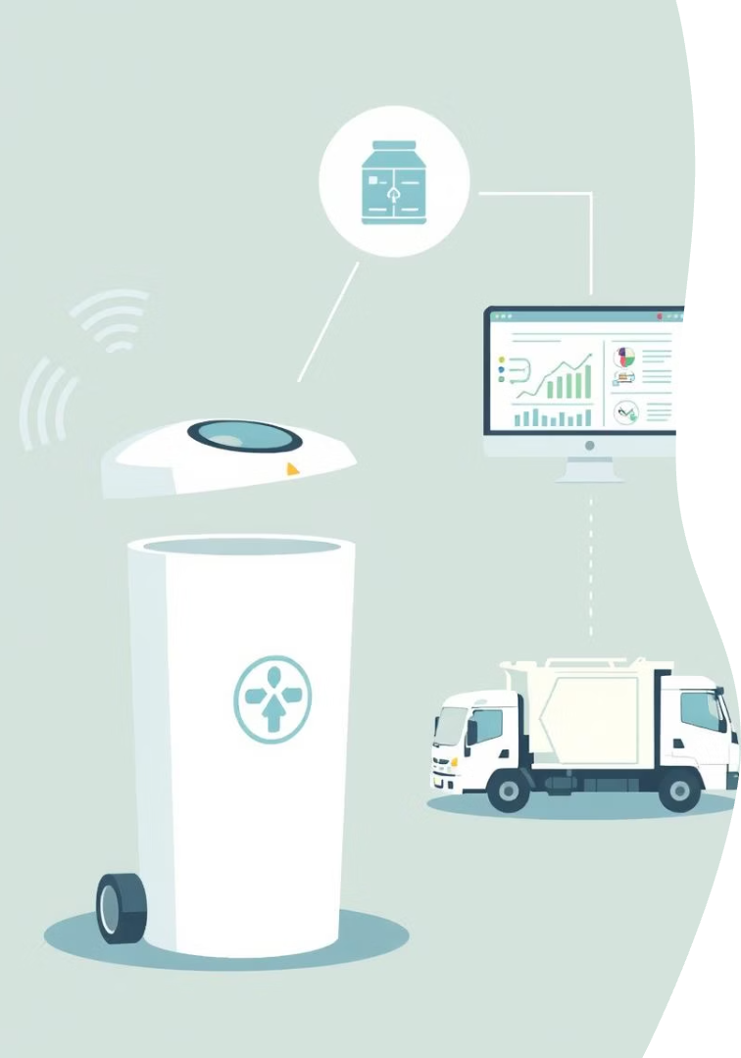
How It Works?
Sensing
Sensors scan waste type as it enters the bin.
Classification
Embedded logic processes sensor data to classify waste.
Segregation
Waste is directed to appropriate compartment automatically.
Data Reporting
Status sent wirelessly to a centralized management system.

Slide 7
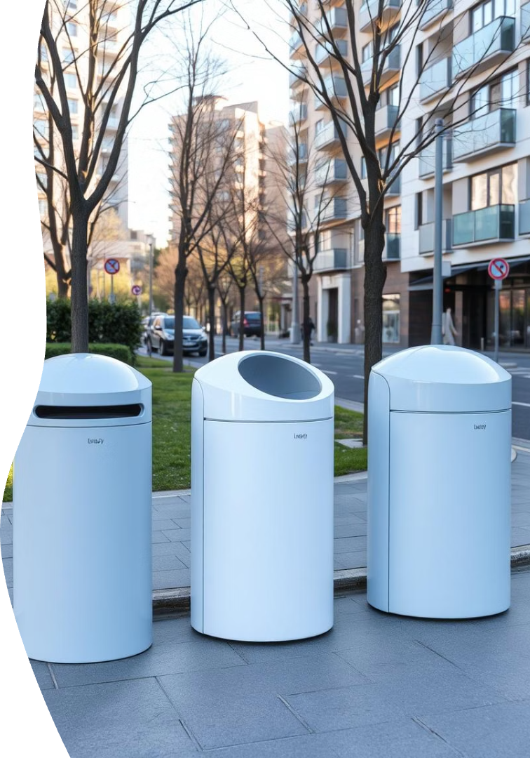
Where Can It Be Used?
Public spaces
Parks, streets, and bus stops for community waste control.
Commercial Buildings
Offices and malls to encourage proper waste segregation.
Residential Complexes
Improve recycling and disposal at home environments.
Educational Institutions
Promote environmental awareness and responsibility in schools.

Slide 8
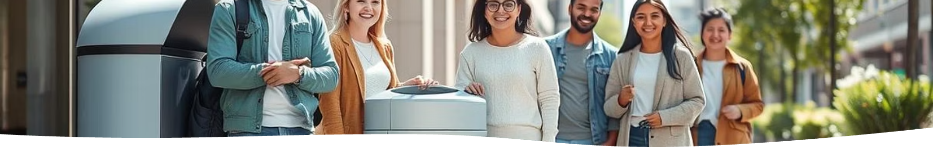
Benefits of the Smart Dustbin
30%
25%
Reduction in landfill waste
Increase in recycling efficiency
Automatically segregates waste to minimize landfill-bound garbage by 30%
Enhances recycling rates by 25% through precise waste classification and separation
40%
20%
Saving in operational costs
Energy savings
Reduces waste collection frequency and labor costs by 40% via real-time fill level monitoring
Optimizes waste processing and collection routes, cutting energy consumption by 20%

Slide 9

Key Takeaways & Next Steps
Smart Design:
Enhances waste management efficiency
Refine sensor algorithms
Improve accuracy in waste classification and sorting.
Expand deployment
Scale the system for widespread urban and residential use.

Slide 10
Thank You

